Slide 1


Microsoft Azure Machine Learning
Andrew Fryer @deepfat
Technical Evangelist
Microsoft

Slide 2
Accelerating the speed of business
PPT REM 12
Big Data
Cloud
Machine Learning

Slide 3
Intelligent action
What happened?
Why did it happen?
What will happen?
What should I do?

Slide 4







Cortana Analytics Suite Transform data into intelligent action
Information Management
Big Data Stores
Machine Learning and Analytics
Dashboards and Visualizations
Business apps
Power BI
Azure
Data Factory
Azure
Machine Learning
Personal Digital Assistant
Azure
Data Lake store
Cortana
Azure Data Lake analytics service
People
Custom apps
Azure
Data Catalog
Perceptual Intelligence
Azure HDInsight
(Hadoop and Spark)
Face, vision
Azure
SQL Data Warehouse
Speech, text
Azure
Event Hub
Azure
Stream Analytics
Business Scenarios
Sensors and devices
Recommendations,
customer churn,
forecasting, etc.
Automated Systems
DATA
INTELLIGENCE
ACTION
INGEST
STORE
ANALYSE
EXPOSE

Slide 5
Cortana Analytics scenarios
EXAMPLE SOLUTIONS
Sales and marketing
Finance and risk
Customer and channel
Operations and workforce
Customer acquisition
Fraud detection
Lifetime customer value
Pay for performance
Cross-sell and upsell
Credit risk management
Personalized offers
Operational efficiency
Loyalty programs
Product recommendation
Smart buildings
Marketing mix optimization
Predictive maintenance
Supply chain management

Slide 6
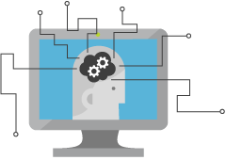
What is Machine Learning (ML)
Computing Systems that become smarter with Experience
Experience = Past Data + Human Input

Slide 7





What is Machine Learning (ML)

Slide 8



Why now?
+
+
=

Slide 9
Machine Learning Process Model
Idea
Data
Business Knowledge
Data Understanding
Data Preparation
Modelling
Evaluation
Publish
Based on the CRISP-DM Model
Re-train

Slide 10
What is Azure Machine Learning
Data
ML ecosystem
Clients
API
Blobs and Tables
Hadoop (HDInsight)
Relational (Azure SQL DB)
OData
Web Based ML Studio
Marketplace
Notes:
The elegance of the solution is in its simplicity – something that has been lacking in the machine learning space
The first issue many enterprises face is data ingestion. With the cloud, you can bring in data sources with the ease of a drop down or drop your on-premises data set into the built in storage space. Users can then model in our development environment – Machine Learning Studio
where we’re offering R, Python and SQLite as first class citizens in addition to our world-class Microsoft algorithms.
The second issue – and often the primary one – is putting finished work into production in a way others can use. Client devices, websites, mobile applications, excel spreadsheets you name it anything that supports HTTP requests.
We’ve heard from many data scientists that they model in R on a Linux stack but then have to hand over their work to developers who need to translate that into another language to actually make it work.
This time consuming and unnecessary process has been eliminated with our system, as the model is with a click transformed into a web service end-point that can run over any data, anywhere and connect to any solution or client.
Next, not only can this model be put into production for your company, it can be made available for the world on our Machine Learning Marketplace. Microsoft hosts your solution and markets it for you, while you have the freedom to brand and monetize as you see fit.

Slide 11
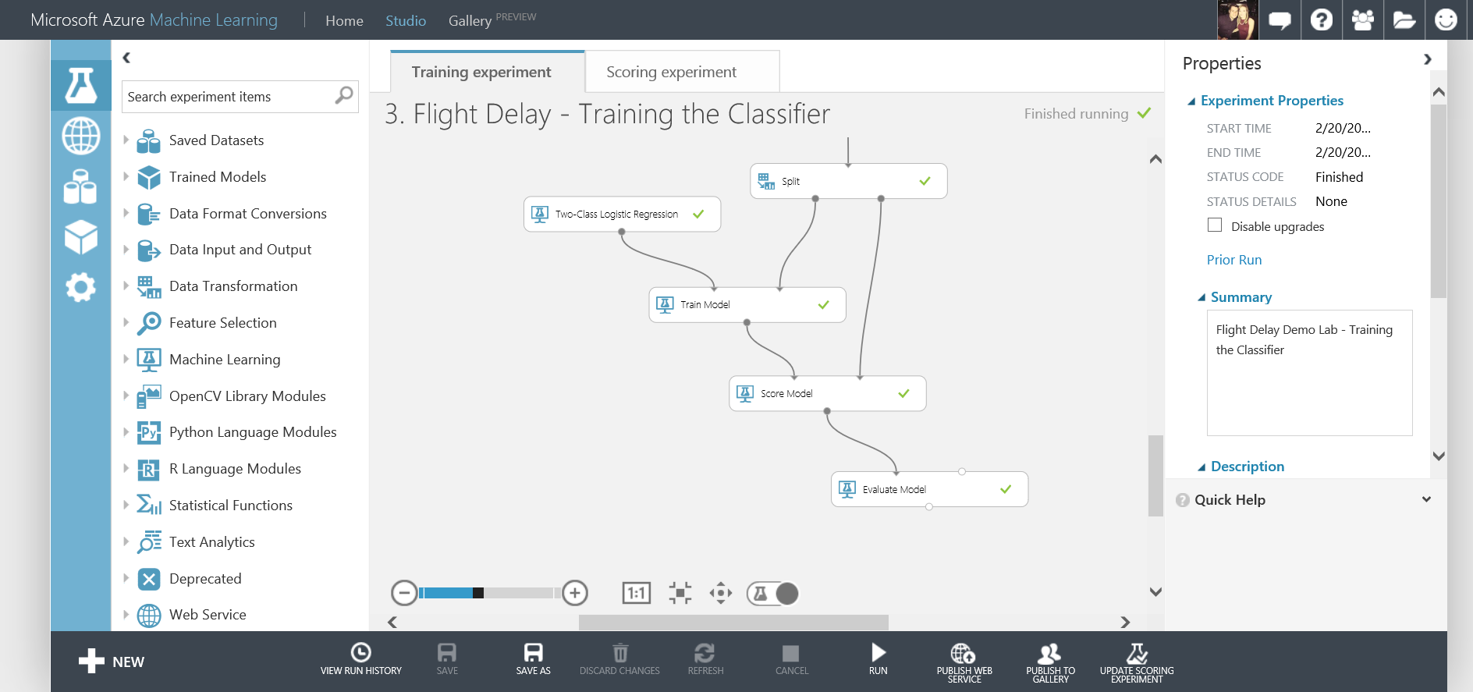
What is Azure Machine Learning
Fully managed cloud service
Accessed via a browser
Best in class machine learning algorithms
Support for R/Python/SQL
Collaborative data science
Quickly deploy models as web services
Publish to a Gallery

Slide 12
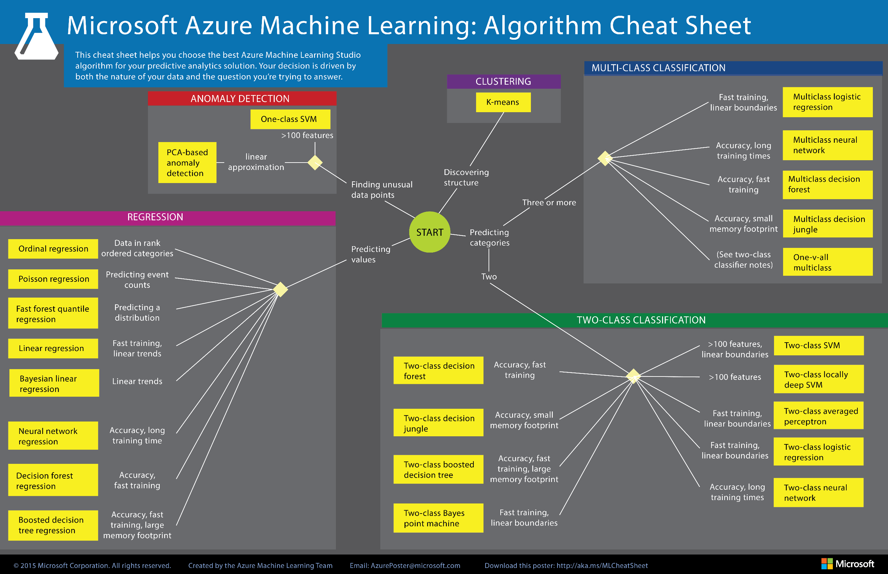

Slide 13
Azure ML Studio Lab
Flight Delay Scenario
Lab Resources are at:
http://1drv.ms/1p9FbTl

Slide 14
Our Scenario
Create and publish a model that predicts:
Will a flight be delayed given a range of flight details and weather data.
Using two datasets: flight delay data and weather data
The model created will be a form of Supervised Learning and will use Binary Classification
Use historical flight and weather data to predict if a future flight is delayed or not.
Finally produce a web service you can query with new flights to gain a prediction

Slide 15
Azure ML Studio Demo

Slide 16
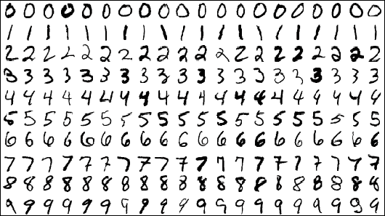
Digit Recognition with Neural Networks
Using a popular MNIST dataset – commonly used in Machine Learning Scenarios for testing Image Processing Systems
42,000 Images, each image is 28 x 28 pixels and each pixel has a value from 0 – 255
No images but a CSV file – 785 columns: label and 784 pixel colours

Slide 17
Azure ML Studio & Python
Jupiter Notebooks
More information: http://blogs.technet.com/b/machinelearning/archive/2015/07/24/introdcing-jupyter-notebooks-in-azure-ml-studio.aspx

Slide 18
Azure ML Studio Demo
Retrain Machine Learning Models
More information:
https://azure.microsoft.com/en-us/documentation/articles/machine-learning-retrain-models-programmatically/

Slide 19
Machine Learning API’s
Project Oxford, Announced at //BUILD
http://www.projectoxford.ai/

Slide 20


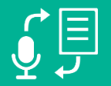

What is Project Oxford?
A portfolio of REST APIs and SDKs which enable developers to write applications which understand the content within the rapidly growing set of multimedia data

Slide 21


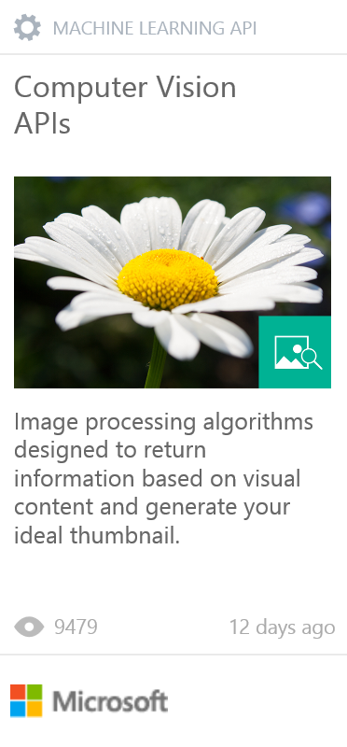
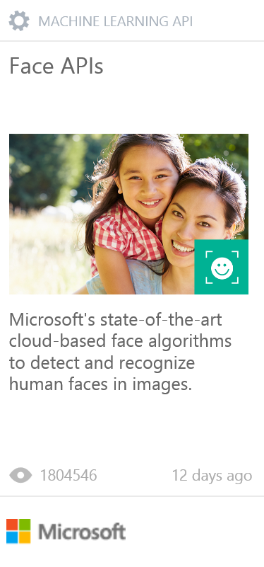
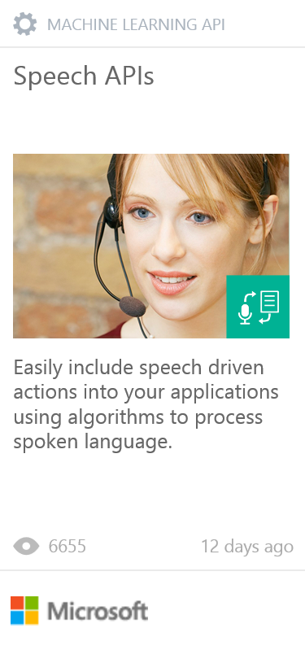
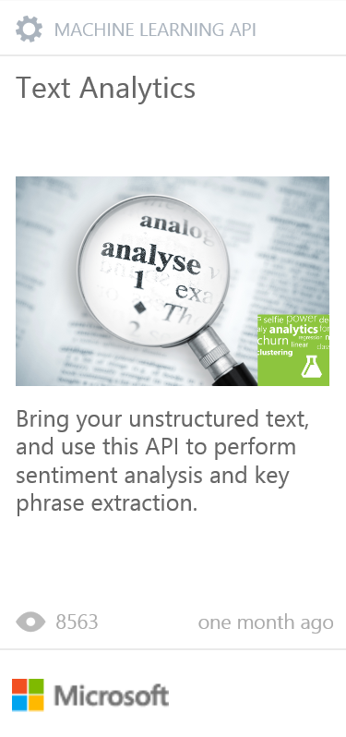
PROJECT OXFORD
Vision APIs
Face APIs
Speech APIs
LUIS
(Language Understanding Intelligent Service)
Speech Recognition
Analyze Image
Face Detection
Detect Intent
Text to Speech
OCR
Face Grouping
Determine Entities
Generate Thumbnail
Face Identification
Speech Intent Recognition
Improve Models

Slide 22
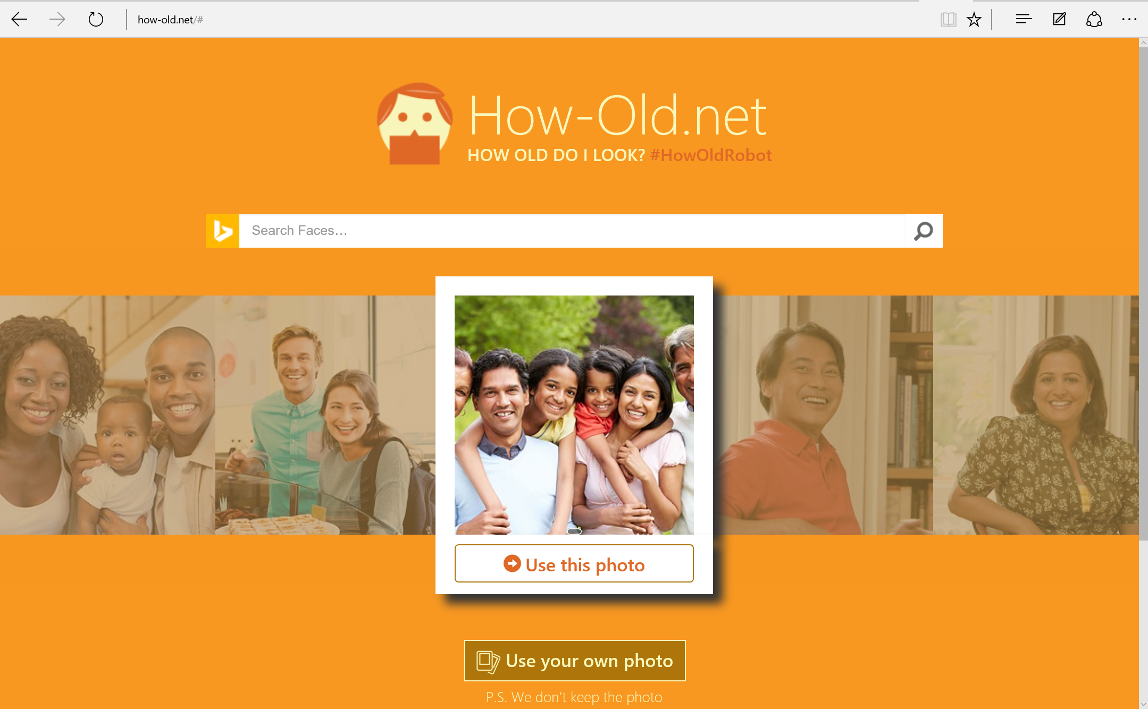

Slide 23
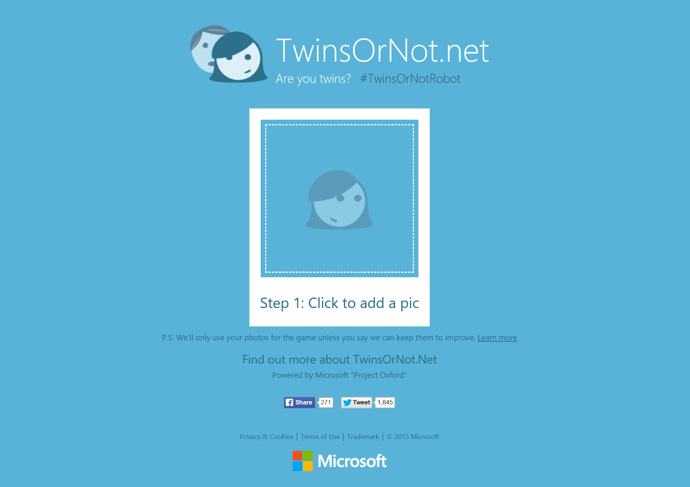

Slide 24

Next Steps
Explore the other Data Services available on Azure
Follow @Fur_Bi!
Find Azure ML Tutorials Available in the Gallery
Build you own solutions using Azure ML!
Get inspired by the examples in the Gallery and start exploring!
Watch the webinars on the Machine Learning Blog http://blogs.technet.com/b/machinelearning/
Do you have your own ideas?...

Slide 25

How did we do?
How satisfied were you with this session?
How satisfied were you with the speaker(s)?
How valuable was the session’s content?
Comments

Slide 26





Thanks for Listening
andrew.fryer@microsoft.com
www.andrewfryer.com
uk.linkedin.com/in/deepfat
@deepfat

Slide 27
Resources
Microsoft Azure Machine Learning Algorithm Cheat Sheet
Microsoft Azure Machine Leaning Documentation
Channel 9 getting started videos for Azure Machine Learning
Using the Azure Machine Learning re-training API
Azure Machine Learning webinars available online to sign up to:
Azure Machine Learning Blog
Introducing Jupyter Notebooks in Azure ML Studio
EXCEL add-in for Azure ML

Slide 28
Advanced Resources
Neural Nets in Azure ML – an introduction to Net #
Quickstart tutorial for the R programming language for Azure Machine Learning

Slide 29
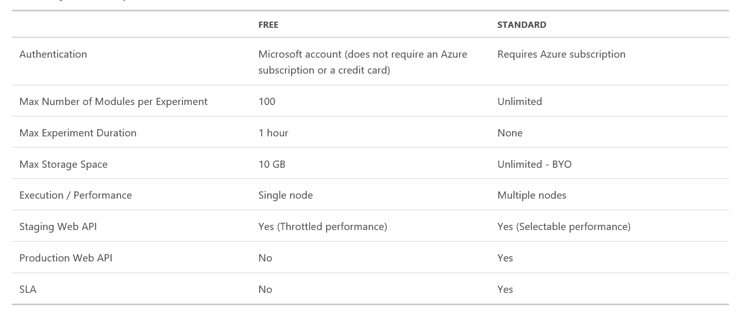
Azure Machine Learning Pricing
Data
Clients
ML STUDIO
Model is now a web service that is callable
Blobs and Tables
Hadoop (HDInsight)
Relational DB (Azure SQL DB)
Integrated development environment for Machine Learning

Slide 30
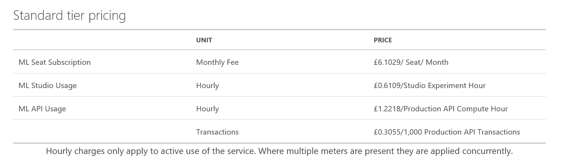
Azure Machine Learning Pricing
Data
Clients
ML STUDIO
Model is now a web service that is callable
Blobs and Tables
Hadoop (HDInsight)
Relational DB (Azure SQL DB)
Integrated development environment for Machine Learning

Slide 31
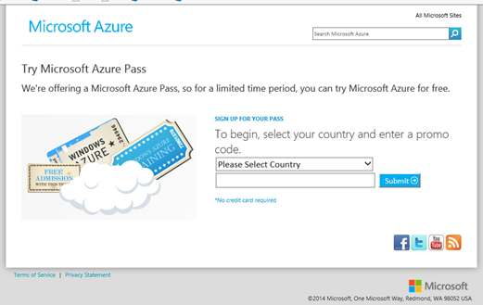
Redeeming Azure Monetary Credit
1. Go to http://microsoftazurepass.com. Select your country, type in the provided promo code and click “Submit.”

Slide 32
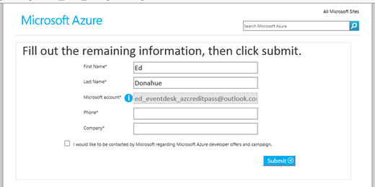
2. Sign into a Microsoft account to continue. If you have an account password saved or you automatically sign into other Microsoft services that Microsoft account will be used to redeem the promo code. (Note: if you have a corp MSFT account, @microsoft.com, please use InPrivate browsing. Otherwise the corp account will be your Microsoft account and the code will be wasted.)
3. Fill out the remaining information and click “Submit.”

Slide 33
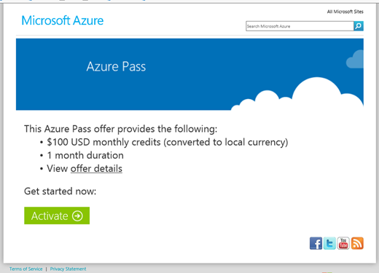
4. Review the Azure Pass offer and click “Activate.”

Slide 34
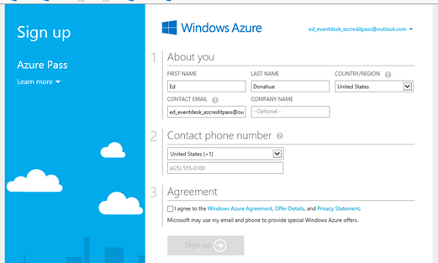
5. Fill out the rest of the required information and click “Sign up.”

Slide 35
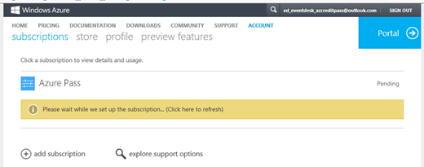
6. The subscription will take 3-10 minutes to activate.

Slide 36
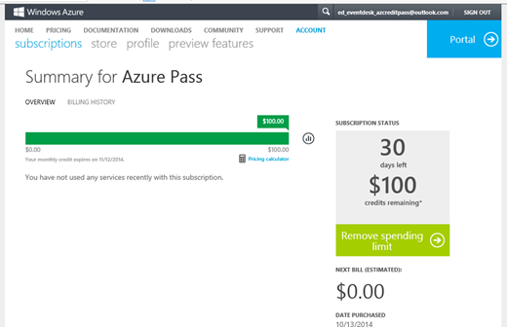
7. Once activated, you will be redirected to the summary page

